Slide 1
PAI 724:
Data Driven Decision making
LAB
Week
October 3, 2021

Slide 2
Lecture Topic
Strings

Slide 3
Programing operations for springs
Collecting, organizing, manipulating string data, or sequences of characters

Slide 4
Concepts relevant for strings
Strings are Immutable

Slide 5
Concepts relevant for strings
Strings are Immutable
While strings are made up of individual characters, python sees strings as one “object”.
This means we can’t change a single character in the string object.

Slide 6
Concepts relevant for strings
Indexing: Identifying positions of characters within string
  Example: variable[x]
“index”
 | H | e | l | l | o | , | x | P | A | I | x | 7 | 2 | 4

Slide 7
Concepts relevant for strings
  hi[length] == hi[14]
position | 0 | 1 | 2 | 3 | 4 | 5 | 6 | 7 | 8 | 9 | 10 | 11 | 12 | 13
 | H | e | l | l | o | , | x | 0 | A | I | x | 7 | 2 | 4
length | 1 | 2 | 3 | 4 | 5 | 6 | 7 | 8 | 9 | 10 | 11 | 12 | 13 | 14

Slide 8
Code Break

Slide 9
Concepts relevant for strings
  hi[length] == hi[14]
position | 0 | 1 | 2 | 3 | 4 | 5 | 6 | 7 | 8 | 9 | 10 | 11 | 12 | 13
 | H | e | l | l | o | , | x | 0 | A | I | x | 7 | 2 | 4
length | 1 | 2 | 3 | 4 | 5 | 6 | 7 | 8 | 9 | 10 | 11 | 12 | 13 | 14
14

Slide 10
Concepts relevant for strings
  hi[length] == hi[14]
  hi[length-1] == hi[13]
position | 0 | 1 | 2 | 3 | 4 | 5 | 6 | 7 | 8 | 9 | 10 | 11 | 12 | 13
 | H | e | l | l | o | , | x | 0 | A | I | x | 7 | 2 | 4
length | 1 | 2 | 3 | 4 | 5 | 6 | 7 | 8 | 9 | 10 | 11 | 12 | 13 | 14
14

Slide 11
Code Break

Slide 12
Concepts relevant for strings
Slicing: Taking segment from a string
hi[n:m]
n-th character → first character to include
m-th character → first character to exclude

Slide 13
Concepts relevant for strings
Slicing: Taking segment from a string
hi[n:m]
n-th character → first character to include
m-th character → first character to exclude
position | 0 | 1 | 2 | 3 | 4 | 5 | 6 | 7 | 8 | 9 | 10 | 11 | 12 | 13
 | H | e | l | l | o | , | x | 0 | A | I | x | 7 | 2 | 4
length | 1 | 2 | 3 | 4 | 5 | 6 | 7 | 8 | 9 | 10 | 11 | 12 | 13 | 14

Slide 14
Concepts relevant for strings
Slicing: Taking segment from a string
hi[n:m]
n-th character → first character to include
m-th character → first character to exclude
position | 0 | 1 | 2 | 3 | 4 | 5 | 6 | 7 | 8 | 9 | 10 | 11 | 12 | 13
 | H | e | l | l | o | , | x | 0 | A | I | x | 7 | 2 | 4
length | 1 | 2 | 3 | 4 | 5 | 6 | 7 | 8 | 9 | 10 | 11 | 12 | 13 | 14

Slide 15
Concepts relevant for strings
Slicing: Taking segment from a string
hi[0:7]
n-th character → first character to include
m-th character → first character to exclude
position | 0 | 1 | 2 | 3 | 4 | 5 | 6 | 7 | 8 | 9 | 10 | 11 | 12 | 13
 | H | e | l | l | o | , | x | 0 | A | I | x | 7 | 2 | 4
length | 1 | 2 | 3 | 4 | 5 | 6 | 7 | 8 | 9 | 10 | 11 | 12 | 13 | 14

Slide 16
Code Break

Slide 17
Concepts relevant for strings
Slicing: Taking segment from a string
hi[0:7]
hi[8:13]
position | 0 | 1 | 2 | 3 | 4 | 5 | 6 | 7 | 8 | 9 | 10 | 11 | 12 | 13
 | H | e | l | l | o | , | x | 0 | A | I | x | 7 | 2 | 4
length | 1 | 2 | 3 | 4 | 5 | 6 | 7 | 8 | 9 | 10 | 11 | 12 | 13 | 14

Slide 18
Concepts relevant for strings
Slicing: Taking segment from a string
hi[0:7]
hi[8:13] → hi[8:]
position | 0 | 1 | 2 | 3 | 4 | 5 | 6 | 7 | 8 | 9 | 10 | 11 | 12 | 13
 | H | e | l | l | o | , | x | 0 | A | I | x | 7 | 2 | 4
length | 1 | 2 | 3 | 4 | 5 | 6 | 7 | 8 | 9 | 10 | 11 | 12 | 13 | 14

Slide 19
Concepts relevant for strings
Slicing: Taking segment from a string
hi[0:7] == hi[:7]
hi[8:13] → hi[8:]
position | 0 | 1 | 2 | 3 | 4 | 5 | 6 | 7 | 8 | 9 | 10 | 11 | 12 | 13
 | H | e | l | l | o | , | x | 0 | A | I | x | 7 | 2 | 4
length | 1 | 2 | 3 | 4 | 5 | 6 | 7 | 8 | 9 | 10 | 11 | 12 | 13 | 14

Slide 20
Code Break

Slide 21
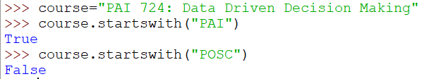
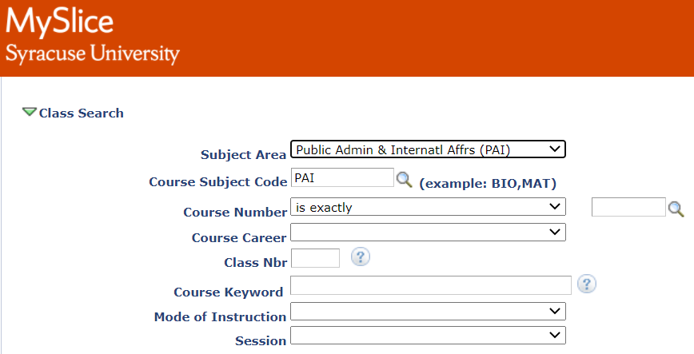
Using String methods

Slide 22
Natural Language Processing (NLP)
Using computational power to classify and detect patterns among human language
Subfield of computer science, linguistics, and artificial intelligence
Leverages ability to detect, process, and manipulate string values
NLP tools:
  Based on dictionary-based classification
  Supervised or unsupervised machine learning
https://www.youtube.com/watch?v=fOvTtapxa9c

Slide 23
A certified organic farming operation must annually pay certification fees and submit an updated organic production system plan or else face revocation of certification.

Slide 24
A
certified
organic
farming
operation
must
annually
pay
submit
certification
fees
updated
organic
production
system
plan
or
else
face
revocation
of
certification
Assigned parts of speech tags

Slide 25
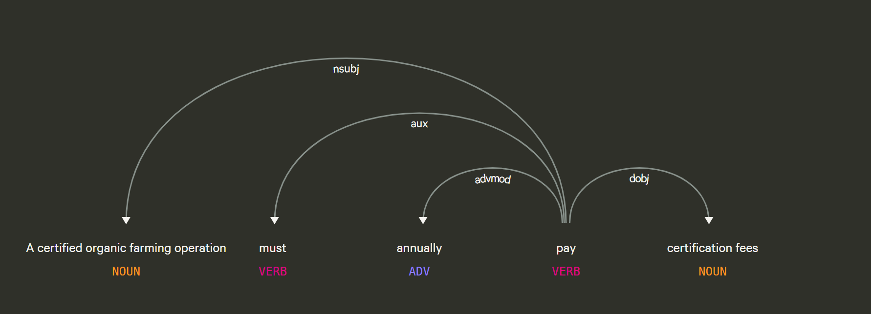

Slide 26
Policy actor
Prescriptive operator
Temporal parameter
Policy relevant action
Policy relevant object
Abstract to general syntax

Slide 27
Content Analysis

Slide 28
What is content analysis?
Technique used to determine the presence of certain words, themes, or concepts within text.

Slide 29
Uses of content analysis
Identify the intentions, focus or communication trends of an individual, group or institution
Describe attitudinal and behavioral responses to communications
Determine psychological or emotional state of persons or groups
Reveal international differences in communication content
Reveal patterns in communication content
Pre-test and improve an intervention or survey prior to launch
Analyze focus group interviews and open-ended questions to complement quantitative dat
https://www.publichealth.columbia.edu/research/population-health-methods/content-analysis

Slide 30
Types of Content analysis
Conceptual
  Explicit representation
  Implicit representation
Relational
  Affect extraction
  Proximity analysis
  Cognitive mapping

Slide 31
Reliability and validity
Reliability
  Stability
  Reproducibility
  Accuracy
Validity
  Closeness of categories
  Conclusions

